Slide 1
Introduction to Programming & Python
Brandon Krakowsky

Slide 2
What is Programming?
A program is a collection of instructions that performs a specific task (or set of tasks) when executed
Programming is a way of specifying (or writing) the instructions
Programming languages vary in many ways:
Syntax: Structure or grammar of the language
Semantics: Meaning of the code. What will it do when I run it?
Speed
Memory management
Etc.

Slide 3
Client-Side vs. Server-Side Programming
Client-side programs run on a client
Client-side programming has mostly to do with a user’s interaction with a user interface
For example, a web page is a client-side program that runs in a web browser, the client
Common client-side programming languages are:
HTML, CSS, and JavaScript
Server-side programs run on a server (or computer)
Server-side programming has mostly to do with the interaction between a user interface and a program on a server
For example, a web page sends messages (or requests) to a program on a server and it processes user input and interacts with a database
Common server-side programming languages are:
Python, Java, PHP, and ASP.NET

Slide 4
What is Python?
Python was named after the TV show Monty Python’s Flying Circus
Python is a high-level programming language
Provides abstraction from the details of the computer
Does most of the work in communicating with the computer
The code is intuitive and easy to understand
Python is an object-oriented programming (OOP) language
Organized around objects rather than “actions”

Slide 5
What is Python?
Python is an interpreted programming language
Does not need to be compiled
Does not need to be converted from one language to another
For example: Java
Is interpreted by a Python interpreter
It’s small and can run on any kind of computer!
This means that sometimes it’s difficult to debug your Python programs
Do not make the mistake of typing out large chunks of code and not testing it at all

Slide 6
Why Python?
Python is an open source programming language
It’s free!
Python is powerful, flexible, and intuitive
There are many Python libraries and resources available online
Closely resembles the English language
Python is good for beginners and a great foundation for other languages!
Python can be used for:
Artificial intelligence/machine learning/natural language processing
Web development
Data analysis & visualization
Game programming
Desktop GUIs
Many other purposes!

Slide 7
Configuring Python & Tools

Slide 8
Download/Installing Python
We will be using Python 3 in this course
If you already have Python 2 installed, please upgrade to Python 3
To download and install Python, go here: https://www.python.org/downloads/ (Download the latest version)
This download/install comes bundled with IDLE (Python’s Integrated Development and Learning Environment)
Includes an interactive Python interpreter and script editor
We’ll eventually be using IDLE to write and run Python scripts

Slide 9
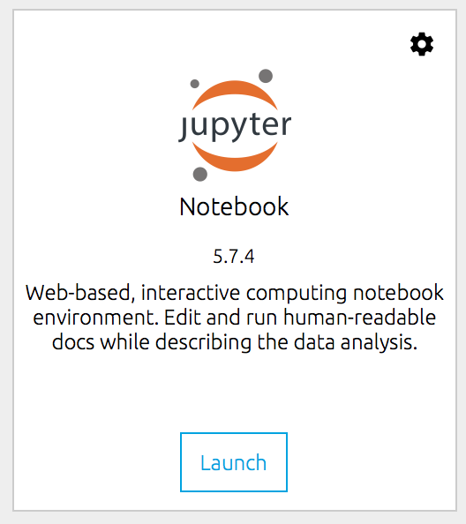
Jupyter Notebook
For the first lecture, we’ll use Jupyter Notebook to write and run Python code
Jupyter Notebook runs in a browser on your computer
Includes interactive Python interpreter and script editor
To install, download Anaconda, a data science platform. This will install Python and Jupyter Notebook all at once: https://www.anaconda.com/products/individual (Download the latest version)
To run, open Terminal on Mac or Command Prompt on Windows and run: jupyter notebook
Or launch from the Anaconda Navigator
For reference: http://jupyter.org/install.html

Slide 10
Using Jupyter Notebook – Keyboard Shortcuts
To execute code in a cell in a notebook Select the cell and press CTRL + Enter
To execute code in a cell in a notebook, and select the next cell Select the cell and press Shift + Enter
To insert a cell above Select the cell and press a
To insert a cell below Select the cell and press b
To delete a cell Select the cell and press dd
To get help with Jupyter Notebook (Keyboard shortcuts) Anywhere outside of a cell, press h
To get help with a Python function Put cursor inside parenthesis of function, and press Shift + Tab

Slide 11
Using Jupyter Notebook – Exporting a Python Script
It’s normal to write, run, and maintain all of your code in a Jupyter Notebook file (.ipynb)
That said, you CAN export a Python script (.py) from a notebook file
Go to “File” --> “Download As” → “Python (.py)”

Slide 12
Python Help – Other Tools
Other Python Tools (IDEs)
PyCharm: Python IDE
https://www.jetbrains.com/pycharm/download/
We’ll use this too!
Eclipse with PyDev: Python IDE for Eclipse
Repl.it: Online editor and interpreter for Python (and other languages)
Text Editors: Emacs, VI, Sublime, etc.

Slide 13
Python Help – Language Resources
Python Language Resources
Python Language Reference: https://docs.python.org/3/reference/index.html

Slide 14
Python Language

Slide 15
How Do I Write Python?
Use the most basic Python print command to output to the console print(“Hello World!”) print(‘Hello World in single quotes’)
You can concatenate (link together) characters and strings using the print command print(‘Today’, ‘is a good day!’)
Change what ends the print statement. (This is normally ‘\n’, i.e. new line) print(‘Good morning,’, end = ‘ ‘) print(‘Brandon!’)
Specify the separator between arguments to print. (This is normally ‘ ‘, i.e. single space) print(‘Good night’, ‘Brandon’, sep = ‘, ‘)
Note: Commands in light blue can be typed directly into a Jupyter Notebook file

Slide 16
Basic Data Types
Every value has a type associated with it
Integer (int): Positive or negative whole number with no decimal points 8 -1
You can do math 2 + 3 5 – 6 2 * 3
Remember the order of operations. You can use parentheses () 3 + 5 – 2 * 6 (3 + 5 – 2) * 6
Use the type command to test if an object is an int type(99)

Slide 17
Basic Data Types
Float (float): A positive or negative number that contains a decimal point 1.3 23.0 -5.1 2 * 3.5 7 / 2.0
Test if an object is a float type(0.1)

Slide 18
Basic Data Types - Arithmetic Operators
Arithmetic operators + addition - subtraction * multiplication / division // integer division, divides and returns the largest whole number, discarding the fractional result (ex. 3 // 2 = 1) ** exponent % modulus, divides and returns the remainder (ex. 7 % 5 = 2)

Slide 19
Basic Data Types - Division
Division: Divides 3 / 2 3.1 / 2
Integer division: Divides and returns the largest whole number, discarding the fractional result 3 // 2 3.1 // 2
Modulus: Divides and returns remainder 3 % 2 4 % 2 3.1 % 2

Slide 20
Basic Data Types
Boolean (bool): True or False 1 == 2 1 < 2 1.2 >= 1.2 ‘Car’ == ‘Car’ ‘Car’ == ‘car’ ‘1’ == 1 ‘1’ != 1
Every object in Python has a boolean value. Test if an object is True or False bool(False) bool(True) bool(7) bool(7 == 0)

Slide 21
Basic Data Types - Comparison Operators
Comparison operators compare values and determine their relationship == equal != not equal (can also use <>) < less than > greater than <= less than or equal to >= greater than or equal to

Slide 22
Basic Data Types
How do we know that 500002 is an even number? 500002 % 2 == 0
Is 500003 odd? 500003 % 2 >= 1

Slide 23
Basic Data Types
String (str): Characters enclosed within single or double quotes ‘Nice!’ ‘Nice’ == “Nice”
Concatenate (link together) characters and strings using a + ‘Wow!’ + ‘ Python is cool!’
Test if an object is a str type(‘yes’) type(“103”) type(103)

Slide 24
Basic Data Types
Printing multiple strings print(‘Name:’, ‘Brandon’, ‘Krakowsky’)
Printing a concatenated string print(‘Name: ‘ + ‘Brandon’ + ‘ Krakowsky’)
Printing strings with special characters print(‘Brandon\’s last name is Krakowsky’) - In Python strings, the backslash (\) is a special character, also called the "escape" character - Prefixing a special character (e.g. single quote) with a backslash (\) turns it into an ordinary character

Slide 25
Basic Data Types - Casting
Converting from one data type to another 12374/621
Did you get something like 19.92592…? What if you cast it to an integer? int(12374/621) - Be careful, it will round DOWN the value to the nearest integer!
If you really want to round a float to the nearest integer, you can use Python’s built-in round function round(12374/621)
You can cast from a string to an integer int(‘1’)

Slide 26
Basic Data Types
Printing with numbers print(4 / 2)
Printing with strings and numbers print(‘4 % 2 =’, 4 % 2)
Printing with strings and numbers concatenated print(‘4 % 2 = ’ + 4 % 2) - This will return an error! - You’re trying to add a str to an int
Try casting print(‘4 % 2 = ’ + str(4 % 2))
Printing with strings and booleans concatenated print(‘Is 4 even? ’ + str(4 % 2 == 0))

